Slide 1
Changes in engagement in HIV prevention and care services among female sex workers in Zimbabwe during intensified community mobilisation
Tendayi Ndori-Mharadze§, Elizabeth Fearon, Joanna Busza, Jeffrey Dirawo, Sithembile Musemburi, Calum Davey, Xeno Acharya, Sibongile Mtetwa, James R Hargreaves, Frances Cowan

Slide 2
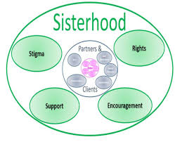
Background
Poor engagement with HIV services among FSWs
ART in public sector since 2004 however FSWs reluctant to attend public clinics
Piloted an intensified community mobilisation project between 2010 and 2015, in Mutare, Hwange and Victoria Falls.
Nested in the nationwide Sisters’ with a Voice program
Notes:
AIM - to foster an enabling environment for sex workers to adopt protective behaviours and increase use of health services we intensified community mobilisation through;
Biweekly peer-delivered community mobilisation sessions
participatory workshops to build solidarity and reduce competition.
training of public sector health workers to be more “sex worker friendly”
Developed and implemented tailored YWSS activities (15-19 years) In 2014
So Ithink I would say we had funding to pilot community mobilisation in three sites 2011-2015 but this was expanded to other 36 sites before the end of that time- just need to be clear it was going on elsewhere and not just piloted throughout this time - don't need to write it just say it.

Slide 3
Methods – 3 methods used
Routine clinical data from 2010 to 2015
Client level data collected using a unique identifier at every clinic visit.
2 RDS surveys in 2011 and 2015 with an HIV test
Estimates were weighted using RDS-1 and estimate convergence assessed in both years.
We assessed differences in six indicators between 2011 and 2015 using logistic regression adjusted for age, duration in sex work and education.
In-depth interviews (n=22) in 2015
With FSWs selected as seeds for the RDS

Slide 4
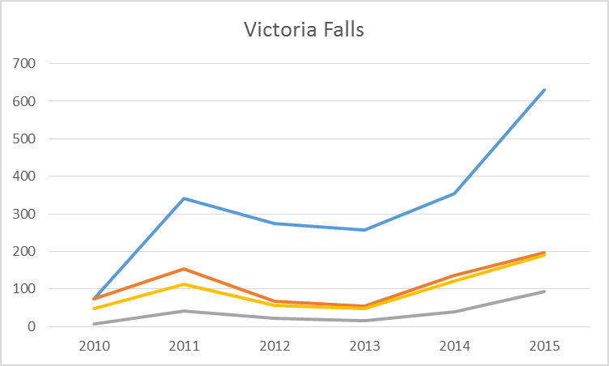
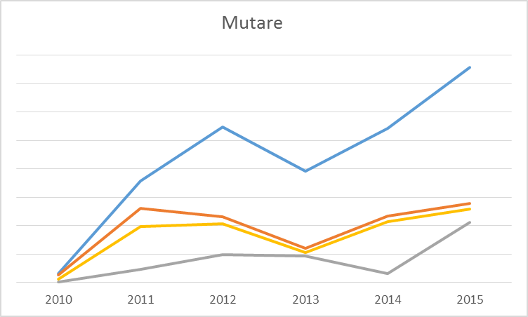
Routine programme data from Sisters’ between 2010 and 2015

Slide 5
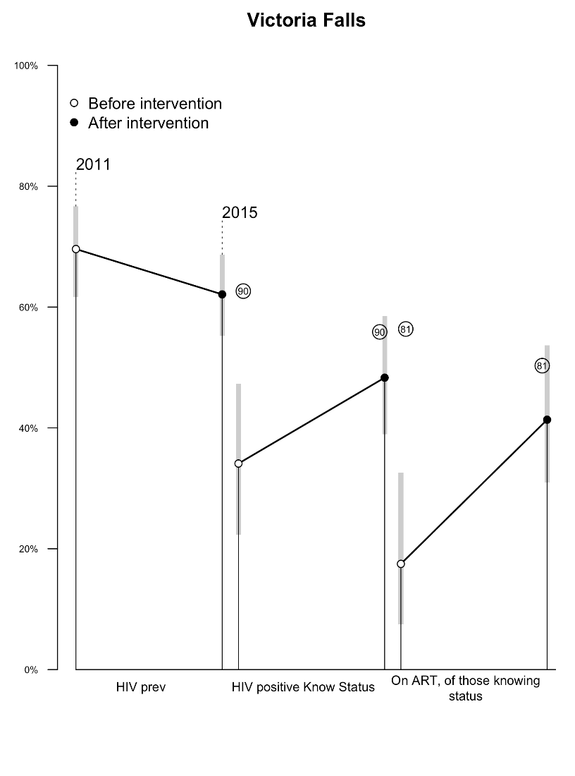
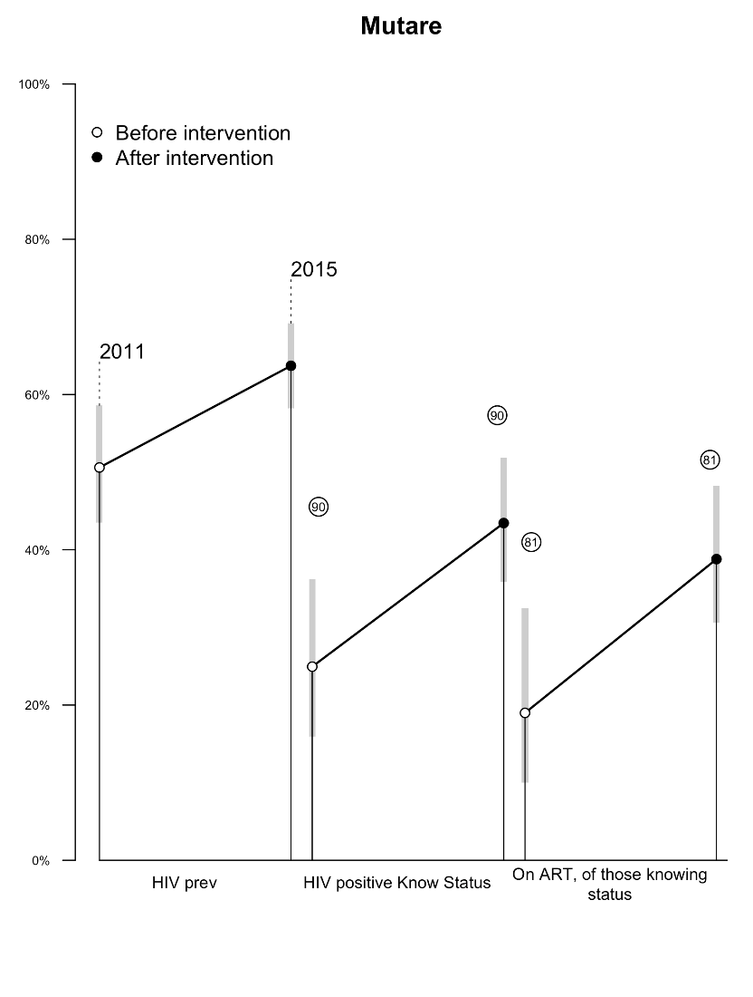
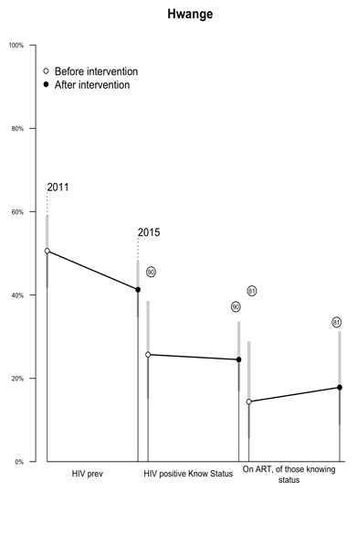
90.90. Cascade before and after the intervention
RDS surveys using same protocol. n=870 in 2011, n= 915 in 2015
Median age 33 at both surveys; sociodemographic characteristics similar
Notes:
Statistically significant difference after logistics regression analysis
- HIV Prevalence - Victoria falls and Hwange,
- HIV positive know status – Victoria Falls and Mutare,
- On ART of those knowing status – Victoria Falls and Mutare
Not statistically significant after logistic regression analysis
- HIV Prevalence – Mutare,
- HIV positive know status – Hwange,
- On ART of those knowing status - Hwange

Slide 6
Increased testing and condom use
RDS surveys using same protocol. n=870 in 2011, n= 915 in 2015
Median age 33 at both surveys; sociodemographic characteristics similar
Notes:
Statistically significant after logistics regression analysis – tested in the last 6 months – all three sites; Consistent condom use with steady partner in the previous month – Mutare and Hwange
Not statistically significant after logistic regression analysis - Consistent condom use with clients in the previous month – all three sites, Consistent condom use with steady partner in the previous month – Victoria Falls

Slide 7
Results 2 – Qualitative results
Widespread fears at start that they might be “outed” as sex workers
Sisters clinics - the mainstay of the program.
Trust-building and sisterhood development
Willing to cooperate and help one another especially in getting HIV tested.
Regular HIV testing seen as a proactive measure FSWs now took.
Not all could be persuaded to attend, especially those who wanted to hide their involvement in sex work/ did not prioritize health.

Slide 8
Conclusion
Observed improvements in HIV testing and prevention indicators
If supported at scale and intensity FSWs can achieve HIV outcomes similar or better than general population
Targeted programs for FSWs can be scaled up and translated into sustainable policies and programs.
Integrating peer-led approaches to biomedical interventions like ART and PrEP for FSWs critical to achieving 90.90.90 targets by 2020.
Notes:
In Zimbabwe 77.1 percent of HIV positive females (15-64 years) know their HIV status. 87.3 percent of HIV-positive females self-report current use of ART. 87.9 percent of HIV-positive females are virally suppressed.

Slide 9
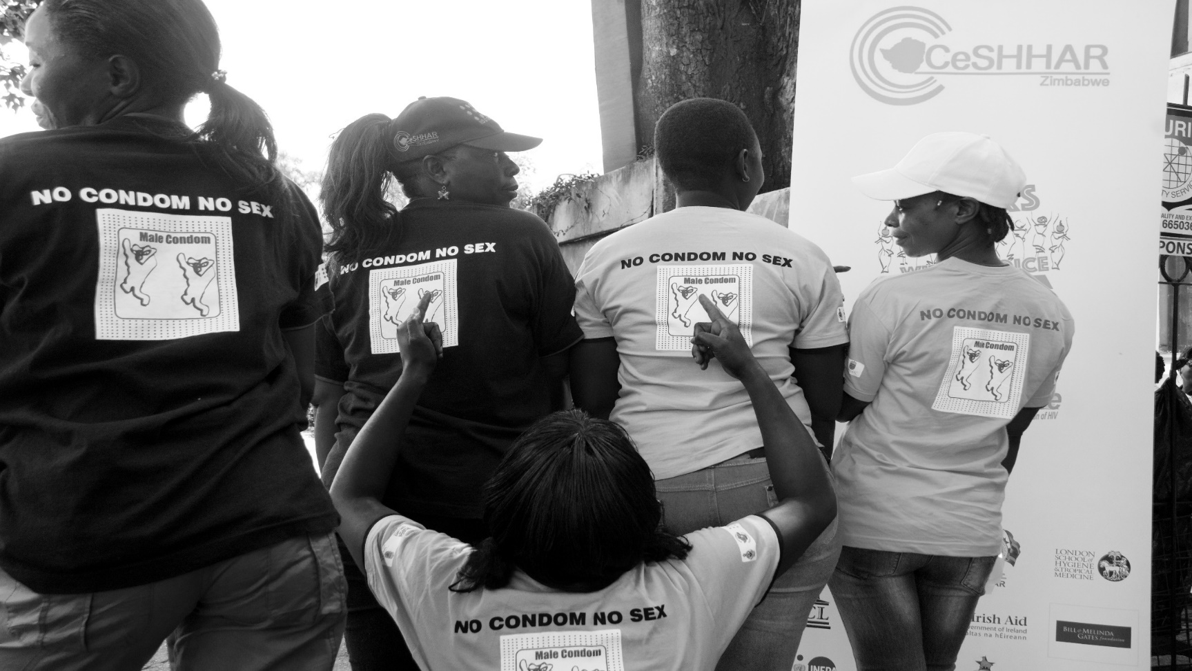
Thank you

